Slide 1
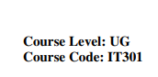



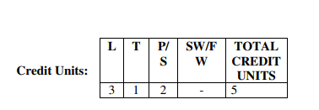
1

Slide 2
Use Case Diagrams

Slide 3

What is UML
Unified Modeling Language (UML) is a general purpose modelling language. The main aim of UML is to define a standard way to visualize the way a system has been designed. It is quite similar to blueprints used in other fields of engineering.
Notes:
If you want to make a building

Slide 4
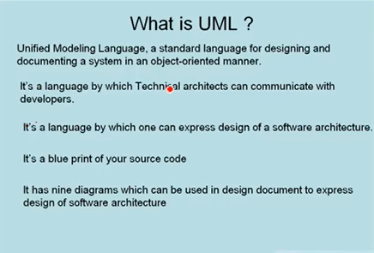
UML

Slide 5
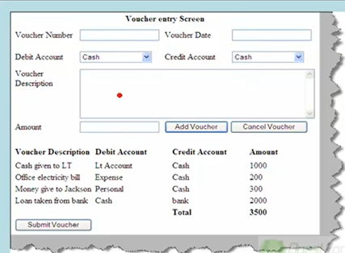
UML

Slide 6
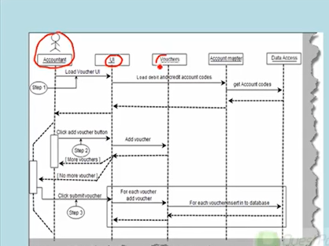
UML

Slide 7
UML
Structural Diagrams – Capture static aspects or structure of a system. Structural Diagrams include: Component Diagrams, Object Diagrams, Class Diagrams and Deployment Diagrams.
Behavior Diagrams – Capture dynamic aspects or behavior of the system. Behavior diagrams include: Use Case Diagrams, State Diagrams, Activity Diagrams and Interaction Diagrams.

Slide 8
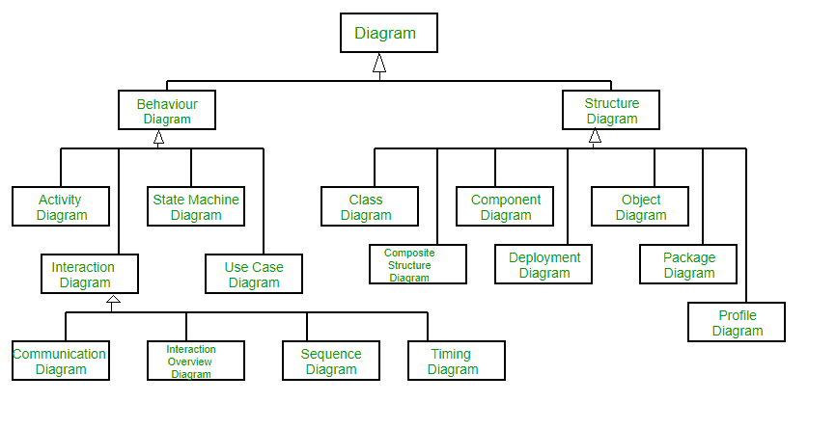
UML

Slide 9
Use Cases
What is a Use Case
A formal way of representing how a business system interacts with its environment
Illustrates the activities that are performed by the users of the system
A scenario-based technique in the UML
A sequence of actions a system performs that yields a valuable result for a particular actor.

Slide 10
Use Case Analysis
What is an Actor?
A user or outside system that interacts with the system being designed in order to obtain some value from that interaction
Use Cases describe scenarios that describe the interaction between users of the system (the actor) and the system itself.

Slide 11
Use Cases
Use case diagrams describe what a system does from the standpoint of an external observer. The emphasis is on what a system does rather than how.
Use case diagrams are closely connected to scenarios. A scenario is an example of what happens when someone interacts with the system.

Slide 12
Use Cases
Here is a scenario for a medical clinic.
A patient calls the clinic to make an appointment for a yearly checkup. The receptionist finds the nearest empty time slot in the appointment book and schedules the appointment for that time slot. "
We want to write a use case for this scenario.
Remember: A use case is a summary of scenarios for a single task or goal.

Slide 13
Use Cases
Step 1 Identify the actors
As we read the scenario, define those people or systems that are going to interact with the scenario.
A patient calls the clinic to make an appointment for a yearly checkup. The receptionist finds the nearest empty time slot in the appointment book and schedules the appointment for that time slot. "

Slide 14
Use Cases
Step 1 Identify the actors
As we read the scenario, define those people or systems that are going to interact with the scenario.
A patient calls the clinic to make an appointment for a yearly checkup. The receptionist finds the nearest empty time slot in the appointment book and schedules the appointment for that time slot. "

Slide 15
Questions for Identifying People Actors
Who is interested in the scenario/system?
Where in the organization is the scenario/system be used?
Who will benefit from the use of the scenario/system?
Who will supply the scenario/system with this information, use this information, and remove this information?
Does one person play several different roles?
Do several people play the same role?
Notes:
Actors
7) Does one person play several different roles?
May have an actor for each role
8) Do several people play the same role?
Only use one actor per role (no matter how many people play that role)
Identifying actors is an iterative process
Defining how an actor interacts with the system may clarify whether there are duplicate actors or not

Slide 16
Questions for Identifying Other Actors
What other entity is interested in the scenario/system?
What other entity will supply the scenario/system with this information, use this information, and remove this information?
Does the system use an external resource?
Does the system interact with a legacy system?
Notes:
Actors
7) Does one person play several different roles?
May have an actor for each role
8) Do several people play the same role?
Only use one actor per role (no matter how many people play that role)
Identifying actors is an iterative process
Defining how an actor interacts with the system may clarify whether there are duplicate actors or not

Slide 17
Actors
An Actor is outside or external the system.
It can be a:
Human
Peripheral device (hardware)
External system or subsystem
Time or time-based event
Represented by stick figure
Notes:
Actors
Are NOT a part of the system (external to the system)
A single actor may represent multiple physical users
Whether human or not, represented by stick figure
MUST label stick figure with the name of the actor

Slide 18
Use Cases
A use case is a summary of scenarios for a single task or goal.
An actor is who or what initiates the events involved in the task of the use case. Actors are simply roles that people or objects play.
So as we read our scenario, what or who is the actor????

Slide 19
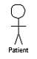
Use Cases
So as we read our scenario, what or who is the actor????
A patient calls the clinic to make an appointment for a yearly checkup. The receptionist finds the nearest empty time slot in the appointment book and schedules the appointment for that time slot. "
The actor is a Patient.

Slide 20
Use Cases
The use case is a summary of scenarios for a single task or goal.
So What is the Use Case????
The Use Case is Make Appointment.
It is a use case for the medical clinic.

Slide 21
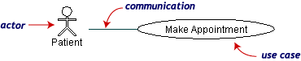
Use Cases
The picture below is a Make Appointment use case for the medical clinic.
The actor is a Patient. The connection between actor and use case is a communication association (or communication for short).
Actors are stick figures. Use cases are ovals. Communications are lines that link actors to use cases.
Actors are stick figures. Use cases are ovals. Communications are lines that link actors to use cases.
Actors are stick figures. Use cases are ovals. Communications are lines that link actors to use cases.

Slide 22
Use Case Componentss
The use case has three components.
The use case task referred to as the use case that represents a feature needed in a software system.
The actor(s) who trigger the use case to activate.
The communication line to show how the actors communicate with the use case.

Slide 23
Use Case Diagram - Use Case
A major process performed by the system that benefits an actor(s) in some way
Models a dialogue between an actor and the system
Represents the functionality provided by the system
Notes:
Use Case
Represent the user functionality (not system functionality)

Slide 24
Use Case
Each use case in a use case diagram describes one and only one function in which users interact with the system
May contain several “paths” that a user can take while interacting with the system
Each path is referred to as a scenario
Notes:
Use Case
In reading a use case, you should not be able to tell if an activity is computerized or manual
Used to document the current system (AS-IS system) or the new system being developed (TO-BE system)
Communicates at a high level what the system needs to do
Captures the typical interaction of the system with the system’s users
Logical model
Physical details are defined during the design phase

Slide 25
Use Case
Labelled using a descriptive verb-noun phrase
Represented by an oval
Make
Appointment
Notes:
Use case: A use case in a use case diagram is a visual representation of a distinct business functionality in a system. The key term here is "distinct business functionality." To choose a business process as a likely candidate for modeling as a use case, you need to ensure that the business process is discrete in nature. As the first step in identifying use cases, you should list the discrete business functions in your problem statement. Each of these business functions can be classified as a potential use case. Remember that identifying use cases is a discovery rather than a creation. As business functionality becomes clearer, the underlying use cases become more easily evident. A use case is shown as an ellipse in a use case diagram Depicted by an oval
MUST label the oval with the name of the use case

Slide 26
Use Case - Actor
Labelled using a descriptive noun or phrase
Represented by a stick character
Notes:
Actors: An actor portrays any entity (or entities) that performs certain roles in a given system. The different roles the actor represents are the actual business roles of users in a given system. An actor in a use case diagram interacts with a use case. For example, for modeling a banking application, a customer entity represents an actor in the application. Similarly, the person who provides service at the counter is also an actor. But it is up to you to consider what actors make an impact on the functionality that you want to model. If an entity does not affect a certain piece of functionality that you are modeling, it makes no sense to represent it as an actor. An actor is shown as a stick figure in a use case diagram depicted "outside" the system boundary, as shown in Make Appointment figure.
Depicted by an oval
MUST label the oval with the name of the use case
To identify an actor, search in the problem statement for business terms that portray roles in the system. For example, in the statement "patients visit the doctor in the clinic for medical tests," "doctor" and "patients" are the business roles and can be easily identified as actors in the system.

Slide 27
Use Case - Relationships
Relationships
Represent communication between actor and use case
Depicted by line or double-headed arrow line
Also called association relationship
Make
Appointment
Notes:
Use Case Relationship
Association relationship
May exist between actor and a use case
Often referred to as a communicate association
Navigable in both directions (actor to use case and use case to actor)
Some use just a line
Others use a double-headed arrowhead
Navigable in only one direction (actor to use case OR use case to actor)
Use a arrowhead where arrowhead denotes the direction of communication
Navigation direction of an association represents who is initiating the communication
Multiplicity
Not consistency shown on all use-case diagrams (Some do; some don’t)

Slide 28
Use Case - Relationships
Boundary
A boundary rectangle is placed around the perimeter of the system to show how the actors communicate with the system.
Make
Appointment
Notes:
System boundary: A system boundary defines the scope of what a system will be. A system cannot have infinite functionality. So, it follows that use cases also need to have definitive limits defined. A system boundary of a use case diagram defines the limits of the system. The system boundary is shown as a rectangle spanning all the use cases in the system.
Other use cases in this lecture also show the system boundary of the clinic application. The use cases of this system are enclosed in a rectangle. Note that the actors in the system are outside the system boundary.
The system boundary is potentially the entire system as defined in the problem statement. But this is not always the case. For large and complex systems, each of the modules may be the system boundary. For example, for an ERP system for an organization, each of the modules such as personnel, payroll, accounting, and so forth, can form the system boundary for use cases specific to each of these business functions. The entire system can span all of these modules depicting the overall system boundary.

Slide 29
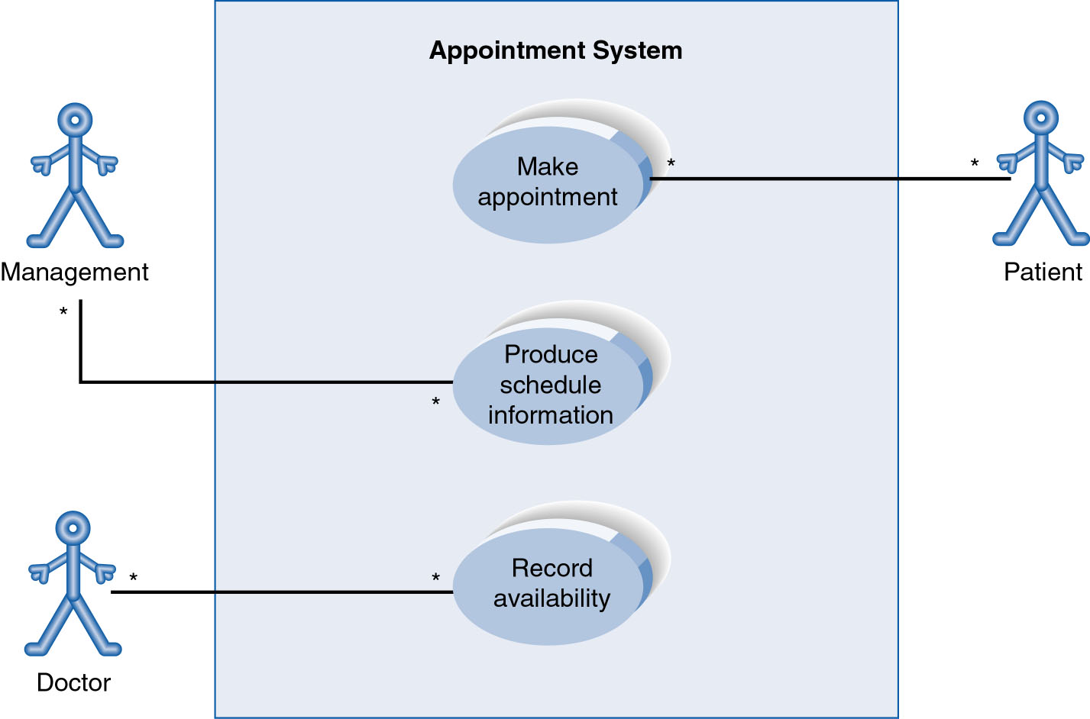
Use-Case Diagram
A use case diagram is a collection of actors, use cases, and their communications.
Notes:
Example Use Case
ACTORS
Represented by a stick figure
named
USE CASE
Represented by an oval
Named (POORLY NAMED; should be verb phrase)
RELATIONSHIP
2-way association

Slide 30

There can be 5 relationship types in a use case diagram.
Association between actor and use case
Generalization of an actor
Extend between two use cases
Include between two use cases
Generalization of a use case

Slide 31
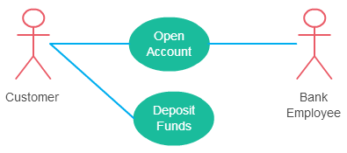
Association between actor and use case
An actor must be associated with at least one use case.
An actor can be associated with multiple use cases.
Multiple actors can be associated with a single use case.
Notes:
Association Between Actor and Use Case
This one is straightforward and present in every use case diagram. Few things to note.
An actor must be associated with at least one use case.
An actor can be associated with multiple use cases.
Multiple actors can be associated with a single use case.

Slide 32
There can be 5 relationship types in a use case diagram.
Association between actor and use case
Generalization of an actor
Extend between two use cases
Include between two use cases
Generalization of a use case

Slide 33
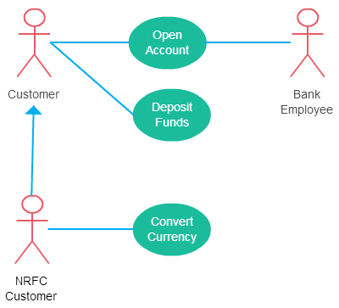
Generalization of an actor
Notes:
Generalization of an actor means that one actor can inherit the role of the other actor. The descendant inherits all the use cases of the ancestor. The descendant has one or more use cases that are specific to that role. Let’s expand the previous use case diagram to show the generalization of an actor.

Slide 34
There can be 5 relationship types in a use case diagram.
Association between actor and use case
Generalization of an actor
Extend between two use cases
Include between two use cases
Generalization of a use case

Slide 35
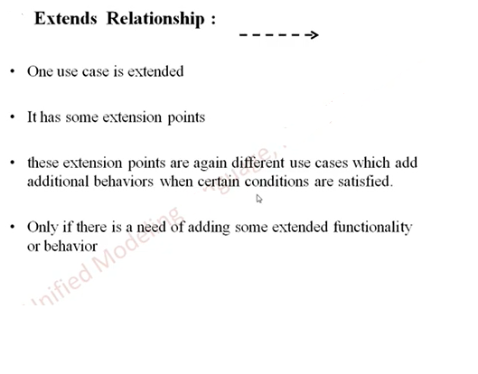
Extend between two use cases

Slide 36
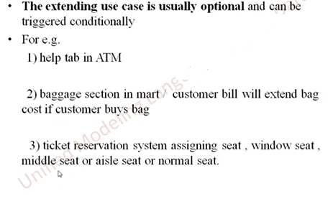
Extend between two use cases

Slide 37
Extend between two use cases
The extending use case is dependent on the extended (base) use case. For example“Calculate Bonus” use case doesn’t make much sense without the “Deposit Funds” use case.
The extending use case is usually optional for example you can see that the extending use case is triggered only for deposits over 10,000 or when the age is over 55.
The extended (base) use case must be meaningful on its own. This means it should be independent and must not rely on the behavior of the extending use case.

Slide 38
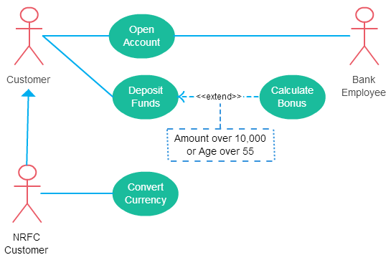
Extend between two use cases

Slide 39
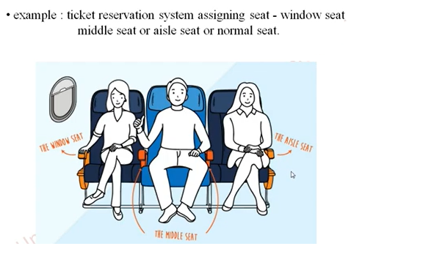
Extend between two use cases

Slide 40
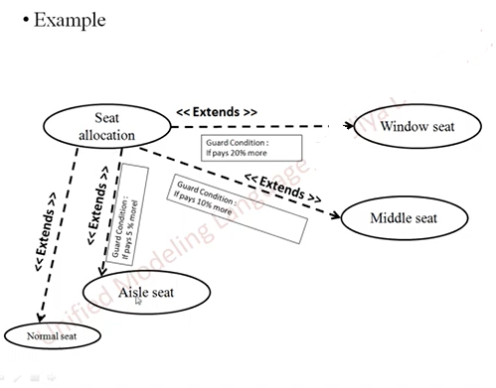
Extend between two use cases

Slide 41
There can be 5 relationship types in a use case diagram.
Association between actor and use case
Generalization of an actor
Extend between two use cases
Include between two use cases
Generalization of a use case
Notes:
Although extending use case is optional most of the time it is not a must. An extending use case can have non-optional behavior as well. This mostly happens when your modeling complex behaviors.
For example, in an accounting system, one use case might be “Add Account Ledger Entry”. This might have extending use cases “Add Tax Ledger Entry” and “Add Payment Ledger Entry”. These are not optional but depend on the account ledger entry. Also, they have their own specific behavior to be modeled as a separate use case.

Slide 42
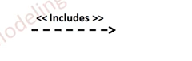
Include relationship show that the behavior of the included use case is part of the including (base) use case. The main reason for this is to reuse common actions across multiple use cases. In some situations, this is done to simplify complex behaviors. Few things to consider when using the <<include>> relationship. The base use case is incomplete without the included use case. The included use case is mandatory and not optional.
Include between two use cases

Slide 43
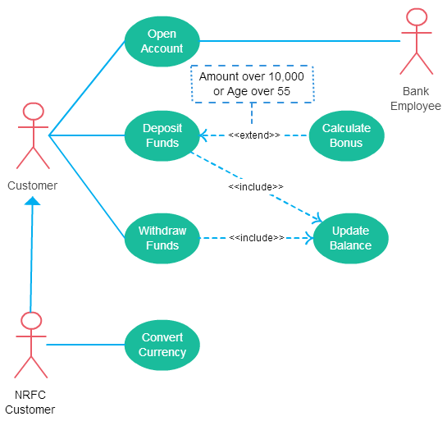
Include between two use cases

Slide 44
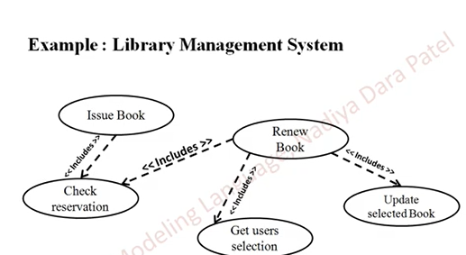
Include between two use cases

Slide 45
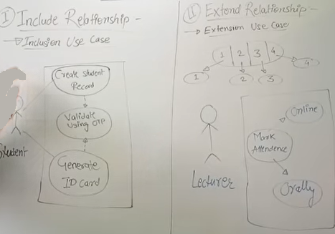
Include and exclude relationship

Slide 46
There can be 5 relationship types in a use case diagram.
Association between actor and use case
Generalization of an actor
Extend between two use cases
Include between two use cases
Generalization of a use case
Notes:
Although extending use case is optional most of the time it is not a must. An extending use case can have non-optional behavior as well. This mostly happens when your modeling complex behaviors.
For example, in an accounting system, one use case might be “Add Account Ledger Entry”. This might have extending use cases “Add Tax Ledger Entry” and “Add Payment Ledger Entry”. These are not optional but depend on the account ledger entry. Also, they have their own specific behavior to be modeled as a separate use case.

Slide 47
Generalization of a use case
This is similar to the generalization of an actor. The behavior of the ancestor is inherited by the descendant. This is used when there is common behavior between two use cases and also specialized behavior specific to each use case.
For example, in the previous banking example, there might be a use case called “Pay Bills”. This can be generalized to “Pay by Credit Card”, “Pay by Bank Balance” etc.
I hope you found this article about use case relationships helpful and useful. You can use our diagramming tool to easily create use case diagrams online. As always if you have any questions don’t hesitate to ask them in the comments section.

Slide 48
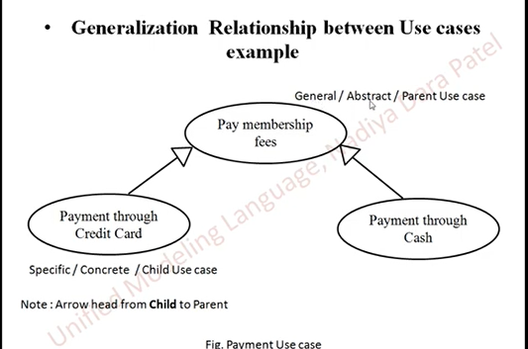
Generalization of a use case

Slide 49
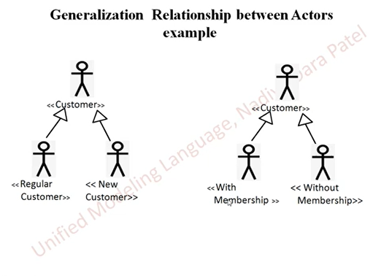
Generalization relationship between actors

Slide 50
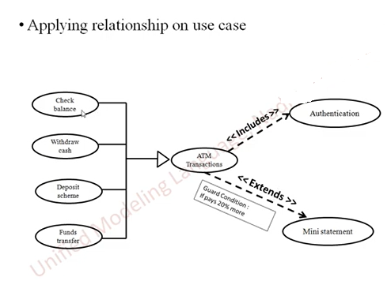
Applying relationship on use case
Child use case
Parent use case

Slide 51
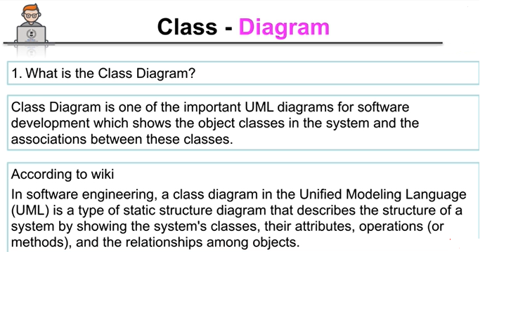
Class Diagram

Slide 52
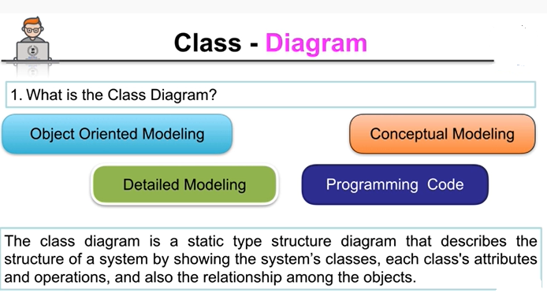
Class Diagram

Slide 53
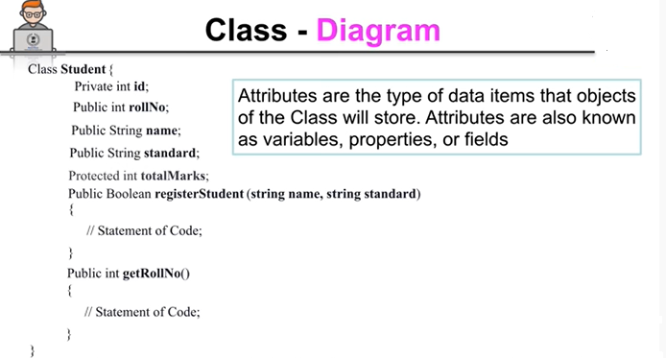
Class Diagram

Slide 54
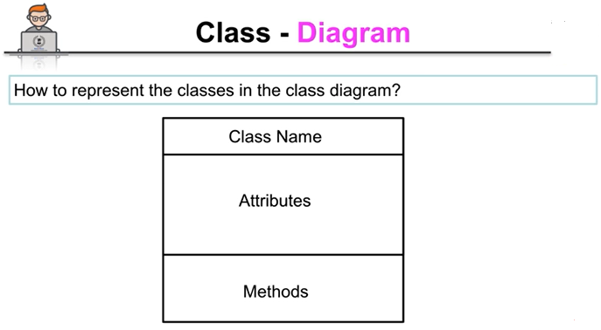
Class Diagram

Slide 55
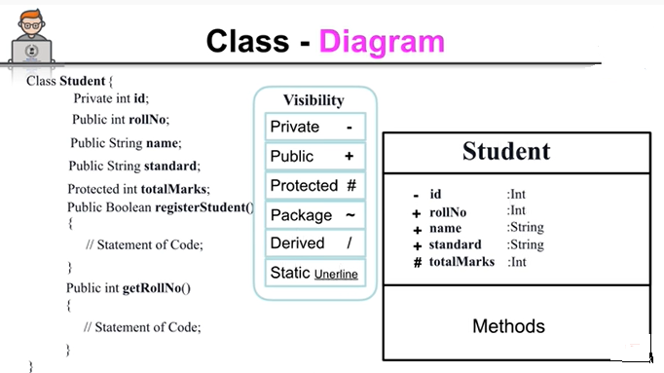
Class Diagram

Slide 56
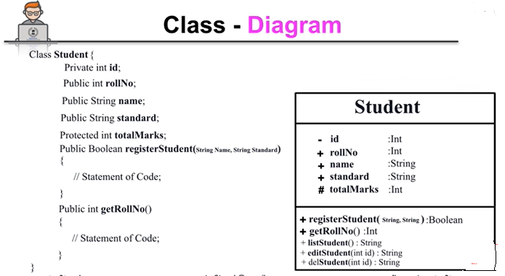
Class Diagram

Slide 57
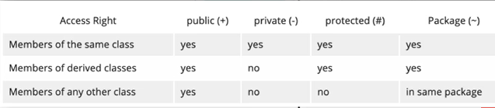
Class Diagram

Slide 58
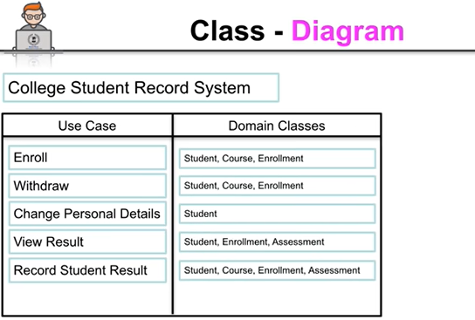
Class Diagram

Slide 59
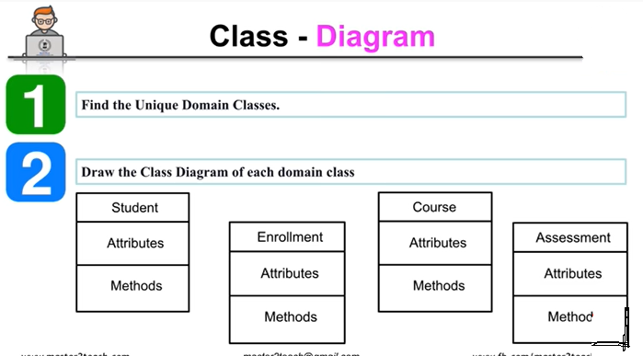
Class Diagram

Slide 60
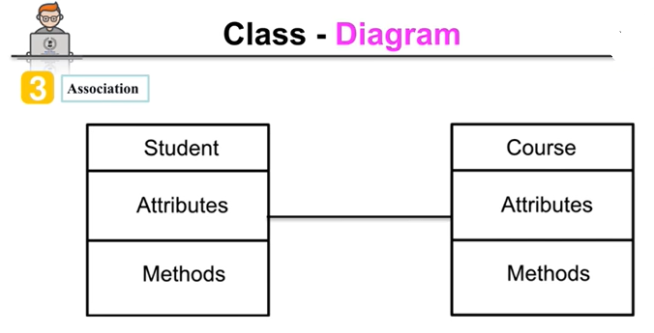
Class Diagram

Slide 61
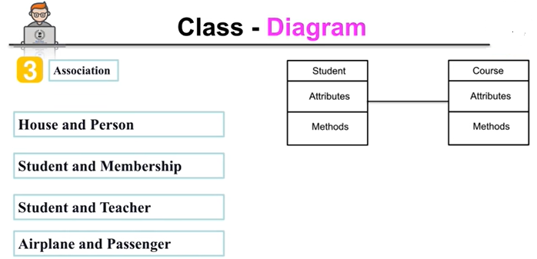
Class Diagram

Slide 62
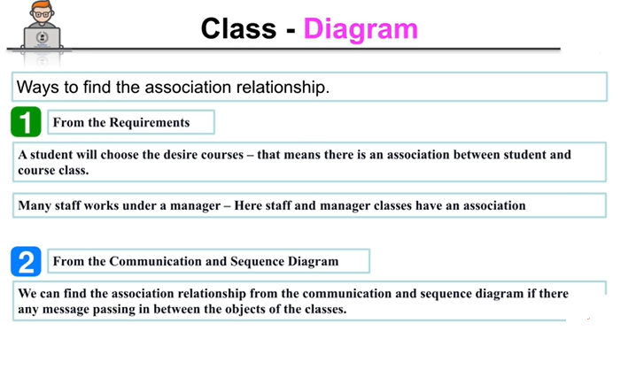
Class Diagram

Slide 63
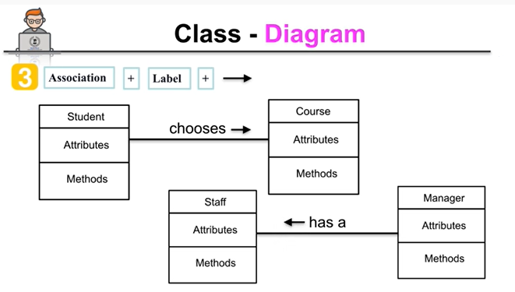
Class Diagram
Notes:
Multiplicity can be set for attributes, operations, and associations in a UML class diagram,

Slide 64
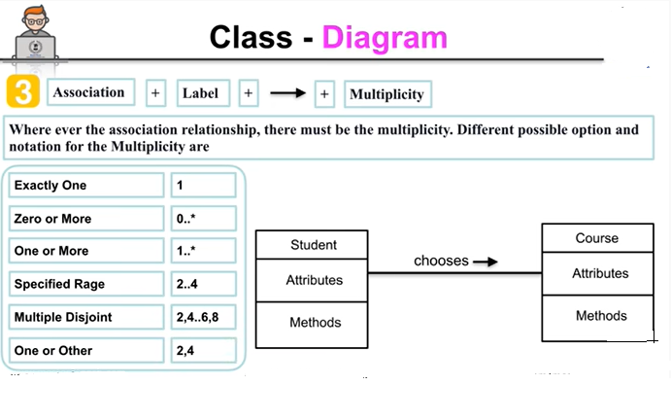
Class Diagram

Slide 65
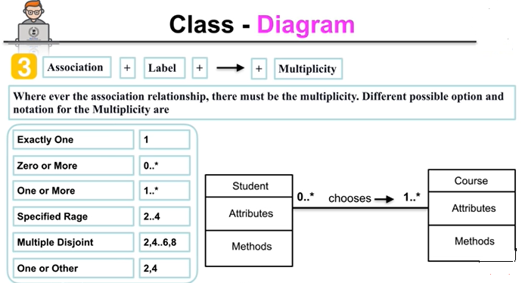
Class Diagram
A course can have zero or more students
Student can choose more than one course

Slide 66
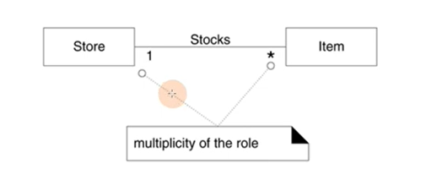
Class Diagram
Multiplicity
A store can have multiple items
Or multiple items can be in one store
Where * indicates zero or more

Slide 67
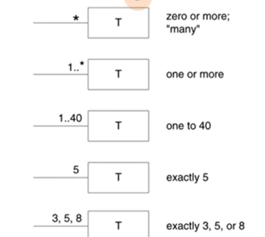
Class Diagram
Multiplicity

Slide 68
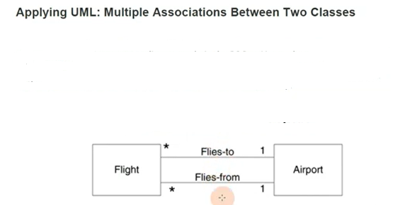
Class Diagram
Multiplicity

Slide 69
Class Diagram
Multiplicity

Slide 70
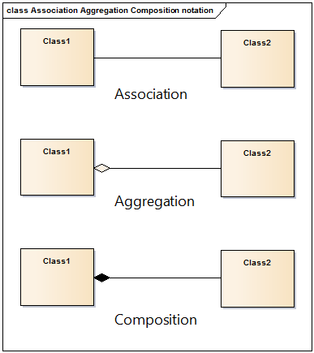
Class Diagram

Slide 71
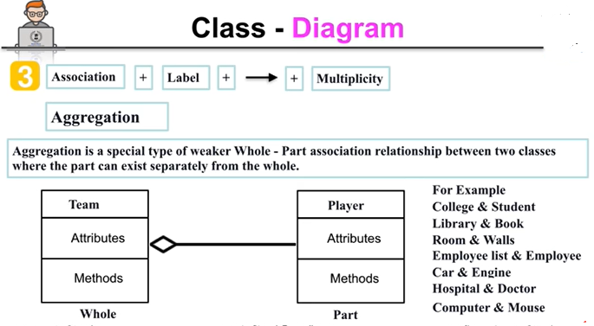
Class Diagram
Notes:
Aggregation and Composition are subsets of association meaning they are specific cases of association. In both aggregation and composition object of one class "owns" object of another class. But there is a subtle difference:
Aggregation implies a relationship where the child can exist independently of the parent. Example: Class (parent) and Student (child). Delete the Class and the Students still exist.

Slide 72
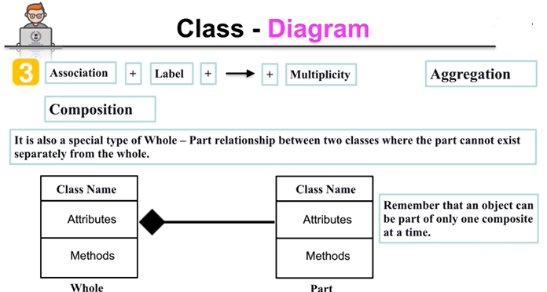
Class Diagram
Notes:
Composition implies a relationship where the child cannot exist independent of the parent. Example: House (parent) and Room (child). Rooms don't exist separate to a House.

Slide 73
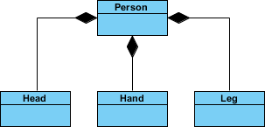
Class Diagram
Notes:
We should be more specific and use the composition link in cases where in addition to the part-of relationship between Class A and Class B - there's a strong lifecycle dependency between the two, meaning that when Class A is deleted then Class B is also deleted as a result

Slide 74
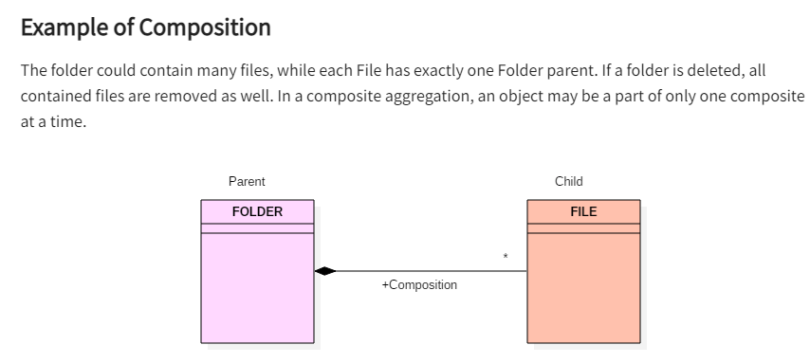
Class Diagram
Notes:
We should be more specific and use the composition link in cases where in addition to the part-of relationship between Class A and Class B - there's a strong lifecycle dependency between the two, meaning that when Class A is deleted then Class B is also deleted as a result

Slide 75
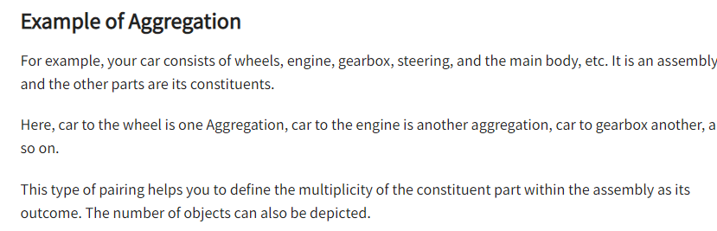
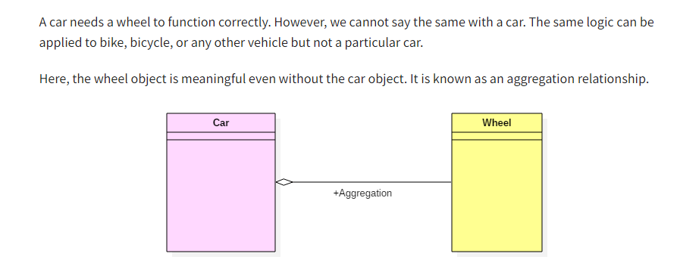
Class Diagram

Slide 76
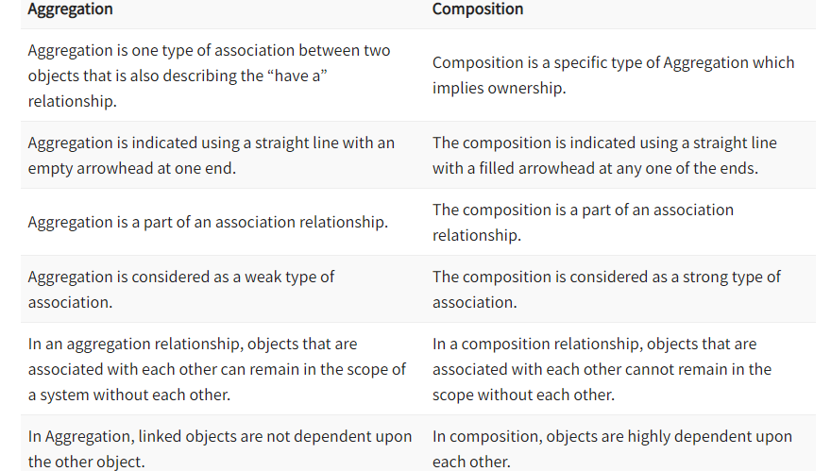
Class Diagram

Slide 77
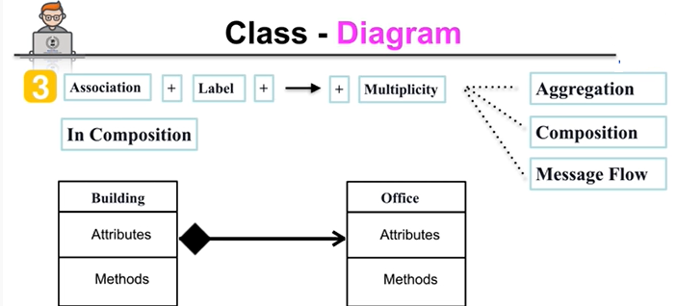
Class Diagram
Here building class can send message to office but vice versa is not true.

Slide 78

Class Diagram

Slide 79

Class Diagram

Slide 80

Class Diagram

Slide 81

Class Diagram

Slide 82

Class Diagram

Slide 83

Class Diagram

Slide 84

Class Diagram

Slide 85

Class Diagram

Slide 86

Class Diagram

Slide 87
Object Diagram
Structural Diagram
A UML object diagram represents a specific instance of a class diagram at a certain moment in time.
An object diagram focuses on the attributes of a set of objects and how those objects relate to each other.
They are be useful to explain smaller portions of your system, when your system class diagram is very complex

Slide 88

Object Diagram
Structural Diagram
Object diagram elements
Object diagrams are simple to create: they're made from objects, represented by rectangles, linked together with lines.
(i) Objects
Objects are instances of a class. For example, if "car" is a class, a 2007 Nissan Altima is an object of a class.
Symbol for object

Slide 89

Object Diagram
Structural Diagram
Object diagram elements
Object Attributes:
Similar to classes, you are able to list object attributes inside a separate compartment. However, unlike classes, object attributes should have values assigned for them.

Slide 90

Object Diagram
Structural Diagram
Object diagram elements
(ii)Class titles
Class titles are the specific attributes of a given class. In the family tree object diagram, class titles include the name, gender, and age of the family members. You can list class titles as items on the object or even in the properties of the object itself (such as color).

Slide 91

Object Diagram
Structural Diagram
Object diagram elements
(iii) Links
Links are the lines that connect two shapes of an object diagram to each other.
Link

Slide 92

Object Diagram
Class to Object Diagram Example - Order System

Slide 93

Object Diagram
Example 1

Slide 94
Sequence Diagram
Sequence Diagrams are interaction diagrams that detail how operations are carried out. They capture the interaction between objects in the context of a collaboration. Sequence Diagrams are time focus and they show the order of the interaction visually by using the vertical axis of the diagram to represent time what messages are sent and when.

Slide 95
Sequence Diagram
Purpose of Sequence Diagram
Model high-level interaction between active objects in a system
Model the interaction between object instances within a collaboration that realizes a use case
Model the interaction between objects within a collaboration that realizes an operation
Either model generic interactions (showing all possible paths through the interaction) or specific instances of a interaction (showing just one path through the interaction)

Slide 96

Sequence Diagram

Slide 97

Sequence Diagram

Slide 98

Sequence Diagram
It has two dimensions
The horizontal axis shows the objects.

Slide 99

Sequence Diagram
It has two dimensions
The vertical axis shows the time from top to bottom

Slide 100
Sequence Diagram Notation
Actor
A type of role played by an entity that interacts with the subject (e.g., by exchanging signals and data)
external to the subject (i.e., in the sense that an instance of an actor is not a part of the instance of its corresponding subject).
represent roles played by human users, external hardware, or other subjects.

Slide 101

Sequence Diagram Notation
Lifeline
A lifeline represents an individual participant in the Interaction.
.

Slide 102

Sequence Diagram Notation
Activations
A thin rectangle on a lifeline) represents the period during which an element is performing an operation.
The top and the bottom of the of the rectangle are aligned with the initiation and the completion time respectively
.

Slide 103

Sequence Diagram Notation
Call Message
A message defines a particular communication between Lifelines of an Interaction.
Call message is a kind of message that represents an invocation of operation of target lifeline.
.

Slide 104

Call Message

Slide 105

Call Message

Slide 106

Sequence Diagram Notation
Return Message
A message defines a particular communication between Lifelines of an Interaction.
Return message is a kind of message that represents the pass of information back to the caller of a corresponded former message.
.

Slide 107

Call Message

Slide 108

Sequence Diagram Notation

Slide 109

Sequence Diagram Notation

Slide 110

Sequence Diagram Notation
Self Message
A message defines a particular communication between Lifelines of an Interaction.
Self message is a kind of message that represents the invocation of message of the same lifeline.

Slide 111

Sequence Diagram Notation
Self Message

Slide 112

Sequence Diagram Notation
Recursive Message
A message defines a particular communication between Lifelines of an Interaction.
Recursive message is a kind of message that represents the invocation of message of the same lifeline. It's target points to an activation on top of the activation where the message was invoked from.

Slide 113

Sequence Diagram Notation
Recursive Message

Slide 114

Sequence Diagram Notation
Create Message
A message defines a particular communication between Lifelines of an Interaction.
Create message is a kind of message that represents the instantiation of (target) lifeline.

Slide 115

Sequence Diagram Notation

Slide 116

Sequence Diagram Notation
Destroy Message
A message defines a particular communication between Lifelines of an Interaction.
Destroy message is a kind of message that represents the request of destroying the lifecycle of target lifeline.

Slide 117

Sequence Diagram Notation
Duration Message
A message defines a particular communication between Lifelines of an Interaction.
Duration message shows the distance between two time instants for a message invocation.

Slide 118
Sequence Diagram Notation
Duration Message
A message defines a particular communication between Lifelines of an Interaction.
Destroy message is a kind of message that represents the request of destroying the lifecycle of target lifeline.

Slide 119

Sequence Diagram Notation
Note
A note (comment) gives the ability to attach various remarks to elements. A comment carries no semantic force, but may contain information that is useful to a modeler.

Slide 120
Sequence Fragments
Sequence Fragments
UML 2.0 introduces sequence (or interaction) fragments. Sequence fragments make it easier to create and maintain accurate sequence diagrams
A sequence fragment is represented as a box, called a combined fragment, which encloses a portion of the interactions within a sequence diagram
The fragment operator (in the top left cornet) indicates the type of fragment
Fragment types: ref, assert, loop, break, alt, opt, neg
.

Slide 121

Sequence Fragments
Sequence Fragments

Slide 122
Sequence Diagram
Advantages
It is convenient to generate.
It has convenient maintenance.
It portrays the flow of messages between various objects.
It can be used to execute forward engineering and reverse engineering as well.
It can conveniently update according to the changes in a system.
It scrutinizes various real-time operations.

Slide 123
Sequence Diagram
Disadvantages
Every sequence requires several notations for their representation, so it can make these diagrams more complicated.
The sequence type can be elected through the message type.
The sequence diagram may get convoluted if there are so many lifelines present in the system.
When the sequence of the message flow modifies, then it may be possible to generate an incorrect outcome.

Slide 124
State Diagram
A state diagram consists of states, transitions, events, and activities. You use state diagrams to illustrate the dynamic view of a system. They are especially important in modeling the behavior of an interface, class, or collaboration.
State diagrams emphasize the event-ordered behavior of an object, which is especially useful in modeling reactive systems.
You use state machines to model the behavior of any modeling element, although, most commonly, that will be a class, a use case, or an entire system which focuses on the event-ordered behavior of an object, which is especially useful in modeling reactive systems.

Slide 125

State Diagram
Key Concepts of a State Machine
A state machine is a behavior that specifies the sequences of states an object goes through during its lifetime in response to events, together with its responses to those events.
A state is a condition or situation during the life of an object during which it satisfies some condition, performs some activity, or waits for some event.

Slide 126
State Diagram
Key Concepts of a State Machine
Transition A solid arrow represents the path between different states of an object. Label the transition with the event that triggered it and the action that results from it. A state can have a transition that points back to itself.

Slide 127

State Diagram
Key Concepts of a State Machine
Initial State A filled circle followed by an arrow represents the object's initial state.

Slide 128

State Diagram
Key Concepts of a State Machine
Final State An arrow pointing to a filled circle nested inside another circle represents the object's final state.

Slide 129

State Diagram
Key Concepts of a State Machine
Synchronization and Splitting of Control
A short heavy bar with two transitions entering it represents a synchronization of control. The first bar is often called a fork where a single transition splits into concurrent multiple transitions. The second bar is called a join, where the concurrent transitions reduce back to one.

Slide 130

State Diagram

Slide 131

State Diagram

Slide 132
Activity Diagram
Activity diagram is another important behavioral diagram in UML diagram to describe dynamic aspects of the system. Activity diagram is essentially an advanced version of flow chart that modeling the flow from one activity to another activity.

Slide 133
Activity Diagram
When to Use Activity Diagram
Activity Diagrams describe how activities are coordinated to provide a service which can be at different levels of abstraction.
Typically, an event needs to be achieved by some operations, particularly where the operation is intended to achieve a number of different things that require coordination, or how the events in a single use case relate to one another, in particular, use cases where activities may overlap and require coordination.
It is also suitable for modeling how a collection of use cases coordinate to represent business workflows
Notes:
Identify candidate use cases, through the examination of business workflows
Identify pre- and post-conditions (the context) for use cases
Model workflows between/within use cases
Model complex workflows in operations on objects
Model in detail complex activities in a high level activity Diagram

Slide 134


Activity Diagram Notation
Activity Is used to represent a set of actions
Action A task to be performed
Control Flow Shows the sequence of execution
Initial Node Portrays the beginning of a set of actions or activities
Activity Final Node Stop all control flows and object flows in an activity (or action)

Slide 135




Activity Diagram Notation
Decision Node Represent a test condition to ensure that the control flow or object flow only goes down one path
Merge Node Bring back together different decision paths that were created using a decision-node.
Fork Node Split behavior into a set of parallel or concurrent flows of activities (or actions)
Join Node Bring back together a set of parallel or concurrent flows of activities (or actions).

Slide 136

Activity Diagram Notation
Swimlane and Partition A way to group activities performed by the same actor on an activity diagram or to group activities in a single thread

Slide 137

Example

Slide 138

Example

Slide 139
Collaboration Diagram
Collaboration diagrams (known as Communication Diagram in UML 2.x) are used to show how objects interact to perform the behavior of a particular use case, or a part of a use case.
Along with sequence diagrams, collaboration are used by designers to define and clarify the roles of the objects that perform a particular flow of events of a use case.
They are the primary source of information used to determining class responsibilities and interfaces.

Slide 140
Collaboration Diagram
What is a Collaboration?
A Collaboration is a collection of named objects and actors with links connecting them. They collaborate in performing some task.
A Collaboration defines a set of participants and relationships that are meaningful for a given set of purposes
A Collaboration between objects working together provides emergent desirable functionalities in Object-Oriented systems
Each object (responsibility) partially supports emergent functionalities
Objects are able to produce (usable) high-level functionalities by working together
Objects collaborate by communicating (passing messages) with one another in order to work together
.

Slide 141
Collaboration Diagram
Why Collaboration Diagram?
Unlike a sequence diagram, a collaboration diagram shows the relationships among the objects.
Sequence diagrams and collaboration diagrams express similar information, but show it in different ways.
Because of the format of the collaboration diagram, they tend to better suited for analysis activities (see Activity: Use-Case Analysis).
Specifically, they tend to be better suited to depicting simpler interactions of smaller numbers of objects. However, if the number of objects and messages grows, the diagram becomes increasingly hard to read.
In addition, it is difficult to show additional descriptive information such as timing, decision points, or other unstructured information that can be easily added to the notes in a sequence diagram.

Slide 142
Collaboration Diagram
Why Collaboration Diagram?
here are some use cases that we want to create a collaboration diagram for:
Model collaborations between objects or roles that deliver the functionalities of use cases and operations
Model mechanisms within the architectural design of the system
Capture interactions that show the messages passing between objects and roles within the collaboration
Model alternative scenarios within use cases or operations that involve the collaboration of different objects and interactions
Support the identification of objects (hence classes) that participate in use cases
Each message in a collaboration diagram has a sequence number.
The top-level message is numbered 1. Messages sent during the same call have the same decimal prefix but suffixes of 1, 2, etc. according to when they occur.

Slide 143
Collaboration Diagram
Notations of Collaboration Diagram
Actors
Normally an actor instance occurs in the collaboration diagram, as the invoker of the interaction. If you have several actor instances in the same diagram, try keeping them in the periphery of the diagram.
Each Actor is named and has a role
One actor will be the initiator of the use case

Slide 144
Collaboration Diagram
Notations of Collaboration Diagram
Objects
An object is represented by an object symbol showing the name of the object and its class underlined, separated by a colon:
Object_name : class_name
You can use objects in collaboration diagrams in the following ways:
Each object in the collaboration is named and has its class specified
Not all classes need to appear
There may be more than one object of a class
An object’s class can be unspecified. Normally you create a collaboration diagram with objects first and specify their classes later.
The objects can be unnamed, but you should name them if you want to discriminate different objects of the same class.

Slide 145
Collaboration Diagram
Notations of Collaboration Diagram
Links
Links connect objects and actors and are instances of associations and each link corresponds to an association in the class diagram
Links are defined as follows:
A link is a relationship among objects across which messages can be sent. In collaboration diagrams, a link is shown as a solid line between two objects.
An object interacts with, or navigates to, other objects through its links to these objects.
A link can be an instance of an association, or it can be anonymous, meaning that its association is unspecified.
Message flows are attached to links, see Messages.

Slide 146
Collaboration Diagram
Notations of Collaboration Diagram
Messages
A message is a communication between objects that conveys information with the expectation that activity will ensue. In collaboration diagrams, a message is shown as a labeled arrow placed near a link.
The message is directed from sender to receiver
The receiver must understand the message
The association must be navigable in that direction

Slide 147

Collaboration Diagram

Slide 148

Component Diagram

Slide 149

Component Diagram

Slide 150

Elements of component diagram
(i)Component
A component is a logical unit block of the system, a slightly higher abstraction than classes. It is represented as a rectangle with a smaller rectangle in the upper right corner with tabs or the word written above the name of the component to help distinguish it from a class.

Slide 151
Elements of component diagram
Component
A component is a logical unit block of the system, a slightly higher abstraction than classes. It is represented as a rectangle with a smaller rectangle in the upper right corner with tabs or the word written above the name of the component to help distinguish it from a class.

Slide 152

Elements of component diagram
(ii)Interface
An interface (small circle or semi-circle on a stick) describes a group of operations used (required) or created (provided) by components. A full circle represents an interface created or provided by the component. A semi-circle represents a required interface, like a person's input.

Slide 153

Elements of component diagram
(iiI) Dependencies
Draw dependencies among components using dashed arrows

Slide 154

Elements of component diagram
(iiI) Port
Ports are represented using a square along the edge of the system or a component. A port is often used to help expose required and provided interfaces of a component.

Slide 155
Relationships
Graphically, a component diagram is a collection of vertices and arcs and commonly contain components, interfaces and dependency, aggregation, constraint, generalization, association, and realization relationships. It may also contain notes and constraints.
Association:
An association specifies a semantic relationship that can occur between typed instances.
It has at least two ends represented by properties, each of which is connected to the type of the end. More than one end of the association may have the same type.

Slide 156
Relationships
(ii) Composition:
Composite aggregation is a strong form of aggregation that requires a part instance be included in at most one composite at a time.
If a composite is deleted, all of its parts are normally deleted with it.

Slide 157
Relationships
(ii) Composition:
Composite aggregation is a strong form of aggregation that requires a part instance be included in at most one composite at a time.
If a composite is deleted, all of its parts are normally deleted with it.

Slide 158
Relationships
(iii) Aggregation
A kind of association that has one of its end marked shared as kind of aggregation, meaning that it has a shared aggregation.

Slide 159

Relationships
(iv) Constraint
A condition or restriction expressed in natural language text or in a machine readable language for the purpose of declaring some of the semantics of an element.

Slide 160
Relationships
(V) Dependency
A dependency is a relationship that signifies that a single or a set of model elements requires other model elements for their specification or implementation.
This means that the complete semantics of the depending elements is either semantically or structurally dependent on the definition of the supplier element(s).

Slide 161
Relationships
(iv) Dependency
A dependency is a relationship that signifies that a single or a set of model elements requires other model elements for their specification or implementation.
This means that the complete semantics of the depending elements is either semantically or structurally dependent on the definition of the supplier element(s).

Slide 162

Case studies

Slide 163

Case studies

Slide 164
Deployment Diagram
Deployment Diagram is a type of diagram that specifies the physical hardware on which the software system will execute.
It also determines how the software is deployed on the underlying hardware. It maps software pieces of a system to the device that are going to execute it.
The deployment diagram maps the software architecture created in design to the physical system architecture that executes it.
In distributed systems, it models the distribution of the software across the physical nodes.
Notes:
The software systems are manifested using various artifacts, and then they are mapped to the execution environment that is going to execute the software such as nodes. Many nodes are involved in the deployment diagram; hence, the relation between them is represented using communication paths.

Slide 165
Deployment Diagram
Purpose of a deployment diagram
Deployment diagrams are used with the sole purpose of describing how software is deployed into the hardware system. It visualizes how software interacts with the hardware to execute the complete functionality.
It is used to describe software to hardware interaction and vice versa.

Slide 166

Deployment Diagram
Deployment Diagram Symbol and notations

Slide 167
Deployment Diagram
What is an artifact?
An artifact represents the specification of a concrete real-world entity related to software development. You can use the artifact to describe a framework which is used during the software development process or an executable file. Artifacts are deployed on the nodes. The most common artifacts are as follows,
Source files
Executable files
Database tables
Scripts
DLL files
User manuals or documentation
Output files

Slide 168
Deployment Diagram
What is an artifact?
Artifacts are deployed on the nodes. It can provide physical manifestation for any UML element. Generally, they manifest components.
Artifacts are labeled with the stereotype <<artifact>>, and it may have an artifact icon on the top right corner.
Each artifact has a filename in its specification that indicates the physical location of the artifact. An artifact can contain another artifact. It may be dependent on one another.
Artifacts have their properties and behavior that manipulates them.
Generally, an artifact is represented as follows in the unified modeling language.

Slide 169

Deployment Diagram
What is an artifact?
Artifacts are deployed on the nodes. It can provide physical manifestation for any UML element. Generally, they manifest components.
Artifacts are labeled with the stereotype <<artifact>>, and it may have an artifact icon on the top right corner.
Each artifact has a filename in its specification that indicates the physical location of the artifact. An artifact can contain another artifact. It may be dependent on one another.
Artifacts have their properties and behavior that manipulates them.
Generally, an artifact is represented as follows in the unified modeling language.

Slide 170

Deployment Diagram
Artifact Instances
An artifact instance represents an instance of a particular artifact. An artifact instance is denoted with same symbol as that of the artifact except that the name is underlined.
UML diagram allows this to differentiate between the original artifact and the instance. Each physical copy or a file is an instance of a unique artifact.
Generally, an artifact instance is represented as follows in the unified modeling language.

Slide 171
Deployment Diagram
What is a node?
Node is a computational resource upon which artifacts are deployed for execution. A node is a physical thing that can execute one or more artifacts.
A node may vary in its size depending upon the size of the project.
Node is an essential UML element that describes the execution of code and the communication between various entities of a system.
It is denoted by a 3D box with the node-name written inside of it.
Nodes help to convey the hardware which is used to deploy the software.

Slide 172

Deployment Diagram
What is a node?
An association between nodes represents a communication path from which information is exchanged in any direction.
Generally, a node has two stereotypes as follows:
<< device >>It is a node that represents a physical machine capable of performing computations. A device can be a router or a server PC. It is represented using a node with stereotype <<device>>.
In the UML model, you can also nest one or more devices within each other.
Following is a representation of a device in UML:

Slide 173

Deployment Diagram
What is a node?
<< execution environment >>It is a node that represents an environment in which software is going to execute. For example, Java applications are executed in java virtual machine (JVM).
JVM is considered as an execution environment for Java applications. We can nest an execution environment into a device node. You can net more than one execution environments in a single device node.
Following is a representation of an execution environment in UML:

Slide 174

Deployment Diagram
Association
In the context of a deployment diagram, an association represents a communication path between nodes. The following diagram shows a deployment diagram for a network, depicting network protocols as stereotypes, and multiplicities at the association ends.

Slide 175

Deployment Diagram

Slide 176
Deployment Diagram
When to use a deployment diagram?
Deployment diagrams are mostly used by system administrators, network engineers, etc. These diagrams are used with the sole purpose of describing how software is deployed into the hardware system. It visualizes how software interacts with the hardware to execute the complete functionality.
To make the software work efficiently and at a faster rate, the hardware also must be of good quality. It must be designed efficiently to make software work properly and produce accurate results in quick time.
Deployment diagrams can be used for,
Modeling the network topology of a system.
Modeling distributed systems and networks.
Forward and reverse engineering processes.

